Slide 1
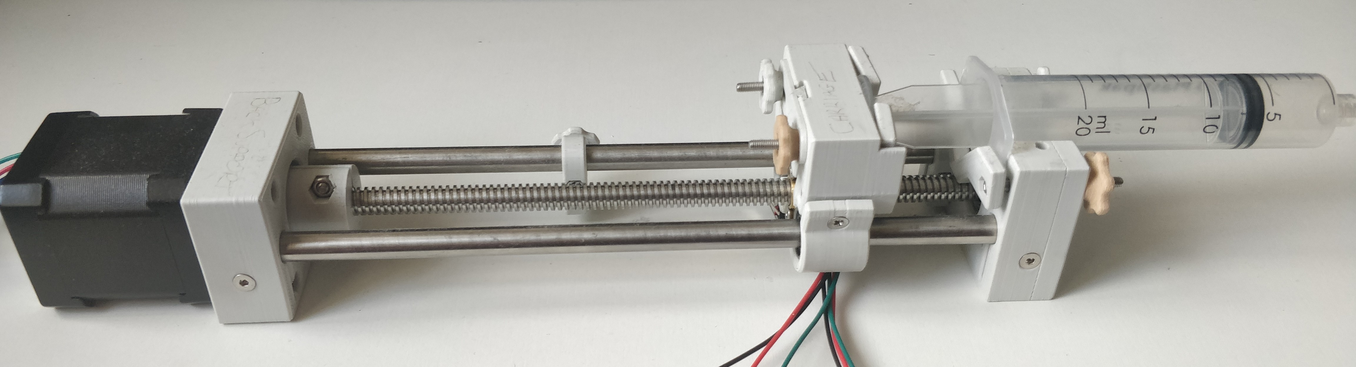
Pumpy Design and Manufacture of a Syringe Pump
Daniel Woolsey

Slide 2
Contents
Project Goals
Development, Design and Manufacturing
Using a 3D Printer
Designing and Building a Syringe Pump
Creating a GUI
Building an Android Application
Demonstration
Project Planning
Conclusions and Future Work

Slide 3
Project Goals
Analyze, Build and Test an Open-Source Syringe Pump
Modify and Improve the hardware
Design a GUI for user friendly operation
Create a mobile application for remote operation
Explore the viability of a cheap and open-source medical Syringe Pump

Slide 4
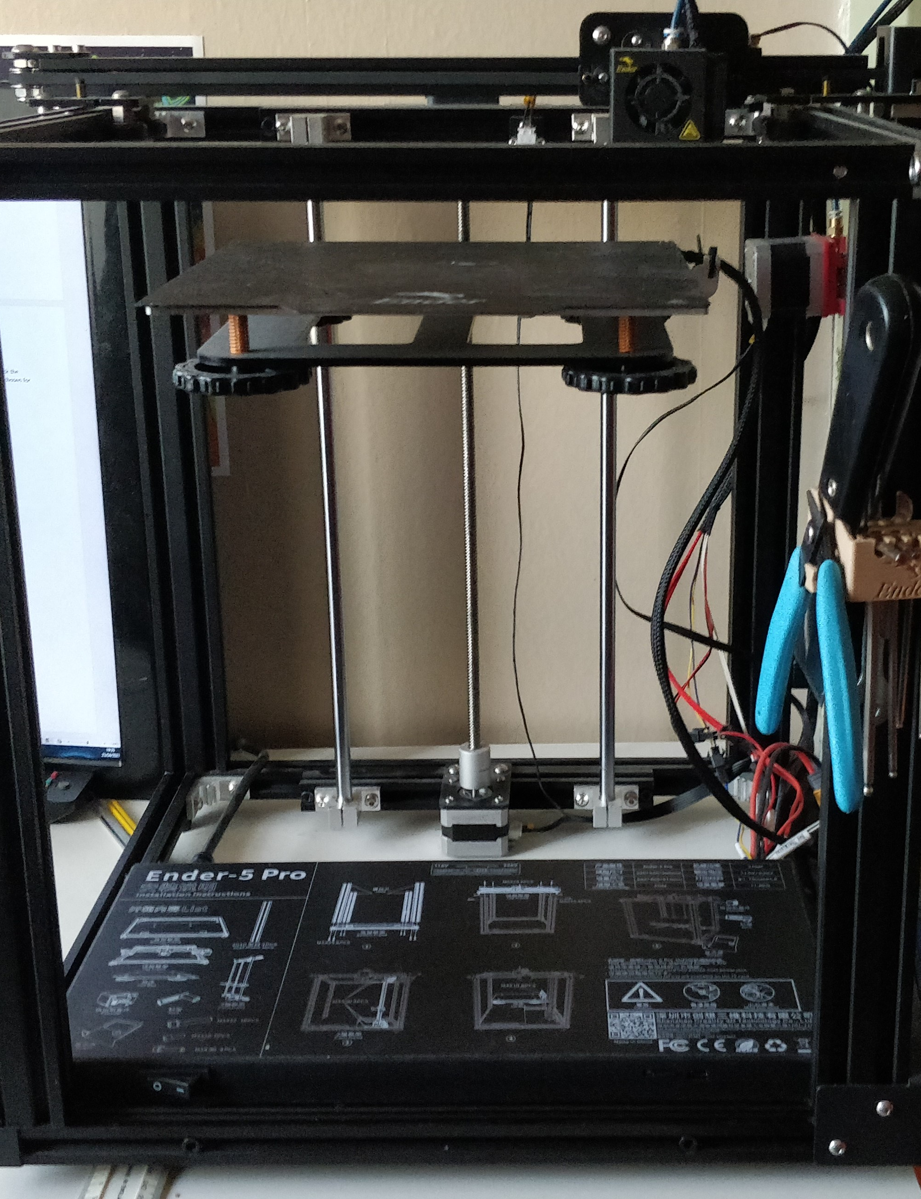
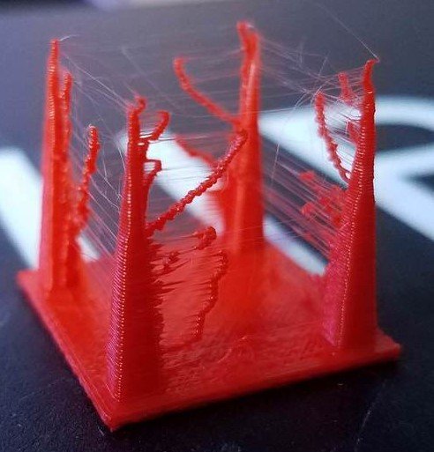
Development, Design and Manufacturing Using a 3D Printer
Hardware Calibration
Printing Material – PLA
Bed Levelling
Use of Software
Slicer – Ultimaker Cura
Print Settings
Print Speed
Retraction
3D Modelling – Fusion 360

Slide 5
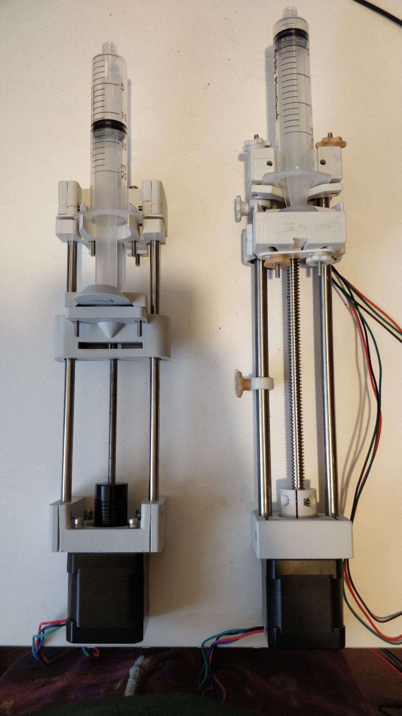
Development, Design and Manufacturing Designing and Building a Syringe Pump
Choosing the Equipment
Raspberry Pi
NEMA 17 Motor and A4988 Driver
Steel and Threaded Rods
Ordering the Hardware and Electronics
Syringe Pump v1 - £112.03
Syringe Pump v2 - £146.22
Creating the Syringe Pumps
V1: OSSPL Proof of Concept with modifications
V2: Overhauled design with new features

Slide 6
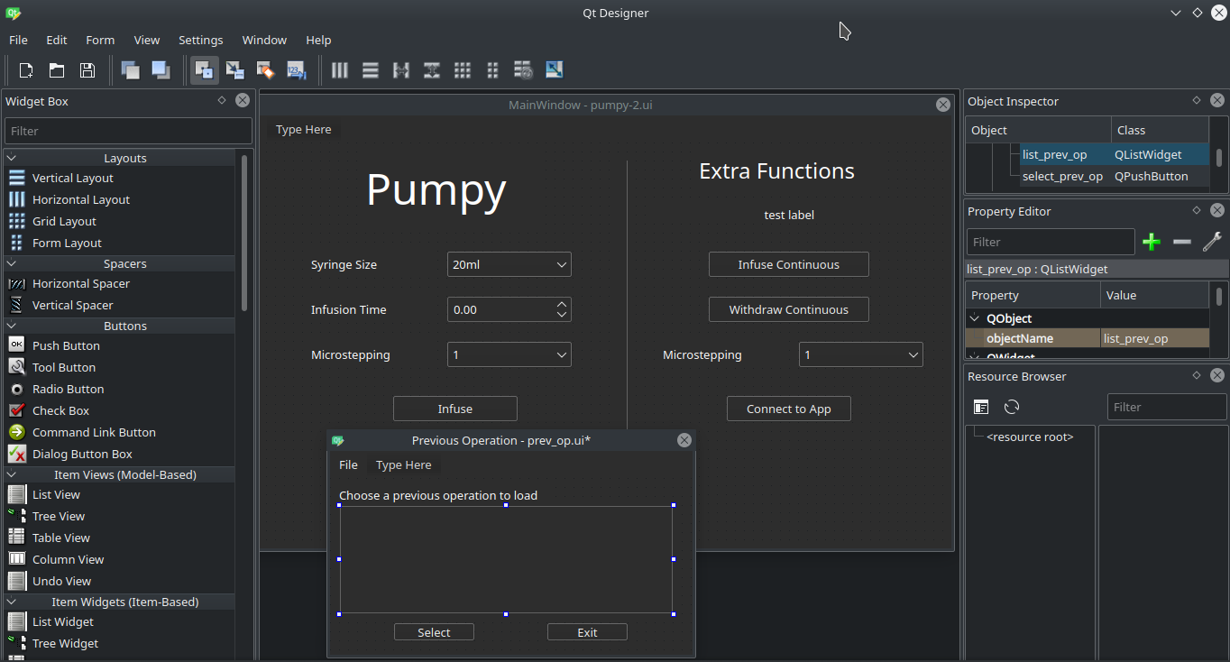
Development, Design and Manufacturing Creating a GUI
Choosing a GUI library – PyQt
Many were tested – Tkinter and Kivy
Design an easy-to-use UI
Performs basic operations
Infusion, Withdrawal, Load Operations
Clean and uncluttered view
Extensible code base
Easy to add new menus with Qt Designer
Libraries for remote operation

Slide 7
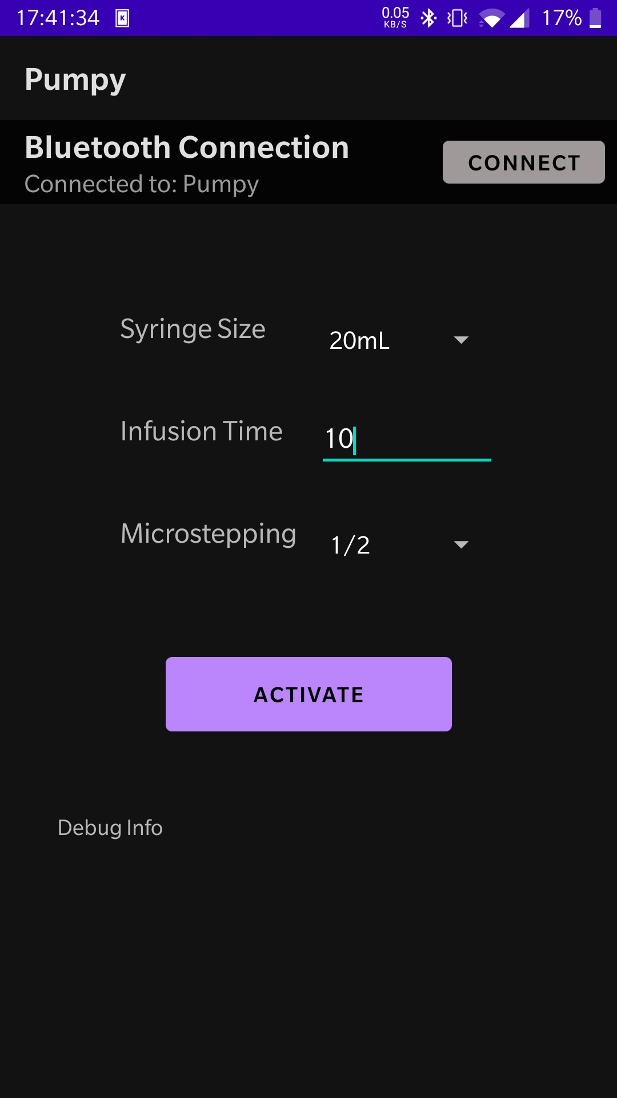
Development, Design and Manufacturing Building an Android Application
Choice of Mobile OS – Android
Most used OS for mobile devices - >70% market share
Method of communication – Bluetooth
Built into Raspberry Pi
Well documented libraries for implementation
Building the Application
Android Studio and Java
Same theme as Pump GUI
Extend Python code to accept Bluetooth

Slide 8
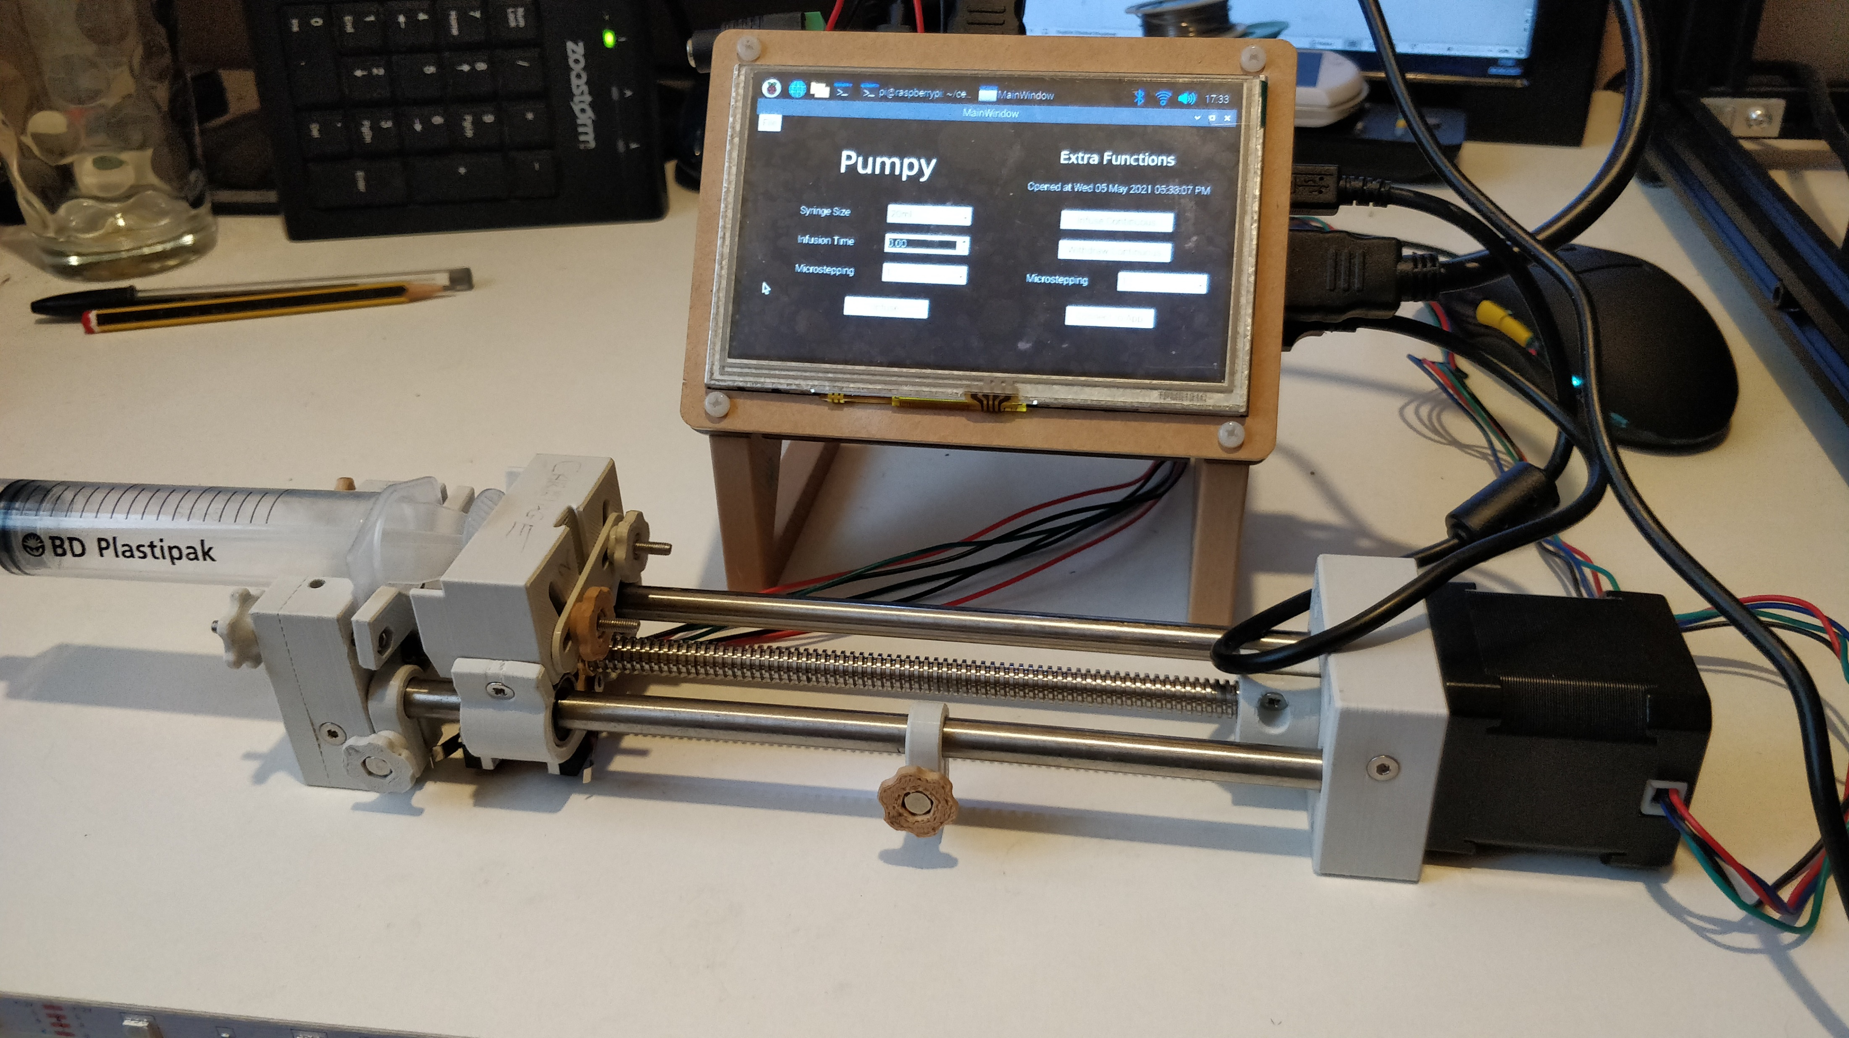
Demonstration

Slide 9
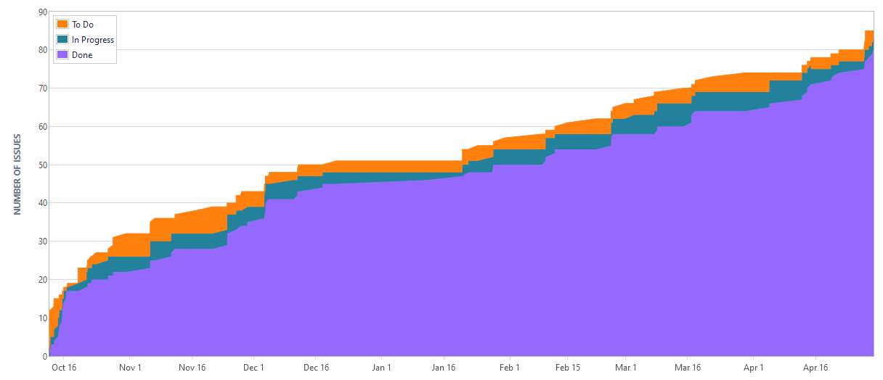
Project Planning

Slide 10
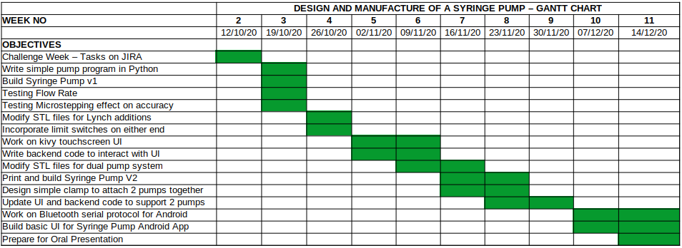
Project Planning
Began with a Gantt Chart
Overestimated workload
Weekly Meetings
Break tunnel vision
Reassess current aims
Use of Gitlab
Easy to document
Simple sharing of code base

Slide 11
Conclusions and Future Work
Built an Open Source Syringe Pump for under £150
Has the potential for medical use
More work would need to be done
Open Source Medical Equipment projects exist
Glia – Open Source Stethoscope
JOGL – Open Source Low Cost Syringe Pump adapted to Hospital Uses
Can continue development of the project through these
Future work to do for my own Syringe Pump
New infusion calculation using flow rate rather than distance moved
Optimize GUI multithreading and allow addition of custom syringes

